Slide 1


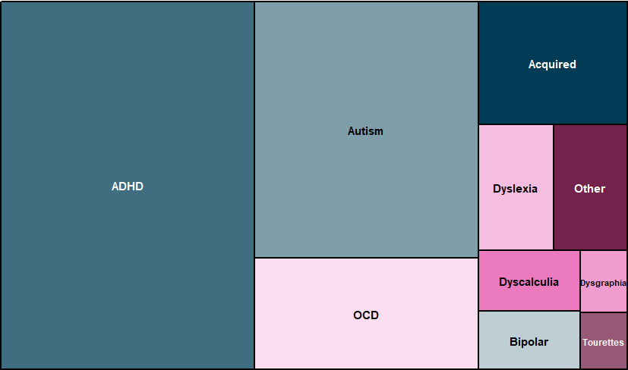
The UoM Neurodiversity Project:
Student Needs-Analysis
Dr. Jessica Riordan, Dr. Sarah Timperley, Dr. Matthew Harrison
Total Participants
Type of Enrolment
Number of Faculties
539
9
189
269
UoM Students
Undergrads
Postgrads
Faculties
Age
Gender
Neurotypes
Note: Students could select more than one condition that they identified with.
Number of conditions identified with
One condition (n=230)
Two conditions (n=142)
Three or more conditions (n=81)

Slide 2
Page two
Academic Motivation and Achievement
“Expectations are not accessibly conveyed to students and asking academic staff for help is discouraged. This leaves me feeling overwhelmed and confused as to how I can succeed.”
Percentage of Students
“My marks at university accurately reflect my ability”
“My marks at university accurately reflect my effort”
Academic Adjustment Plans
40%
Percentage of Students
only
of participants have an official Academic Adjustment Plan
“I didn’t even know they were an option”
They are extremely hard to apply for
Formal diagnoses are prohibitively expensive and waiting lists are too long
“Their proposed accommodations wouldn’t meet my needs”
Students with an AAP: “The accommodations on my plan help me to achieve better marks”
Discrimination at the University of Melbourne
64%
49%
40%
have heard insensitive or disparaging remarks about neurodivergent people from other students
have heard insensitive or disparaging remarks about neurodivergent people from academic staff members
have experienced offensive and negative comments about neurodivergence directed towards them

