Slide 1
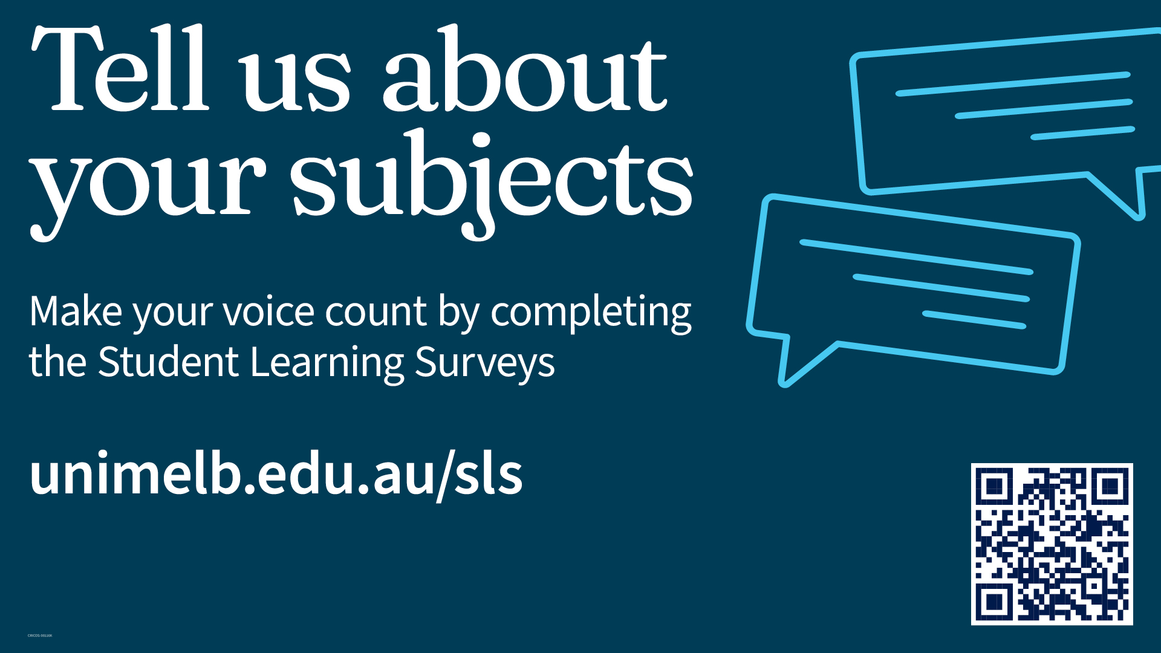

Slide 2
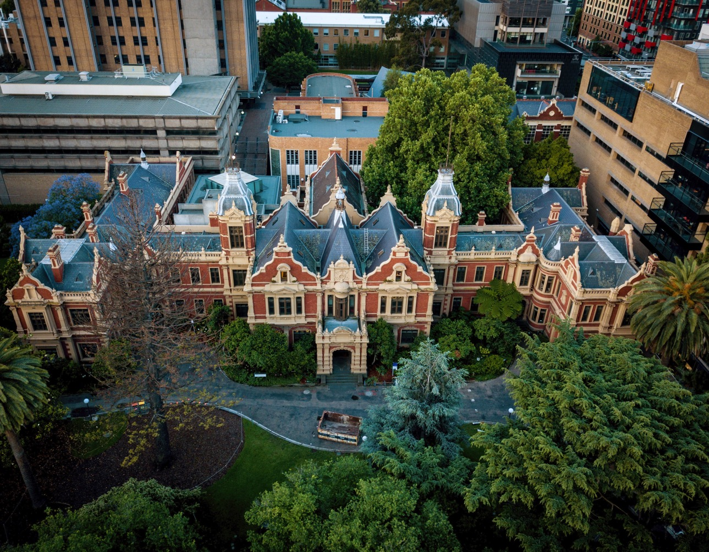
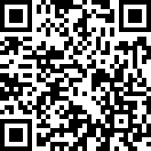
End of subject survey
Results from the Student Learning Surveys (SLS) provide valuable feedback to the University and to your Subject Coordinators for subject improvements for future cohorts.
All end of semester surveys are completely anonymous – all entries are de-identified.
More information can be found in the student FAQs:
unimelb.edu.au/sls/students/faqs

